Slide 1

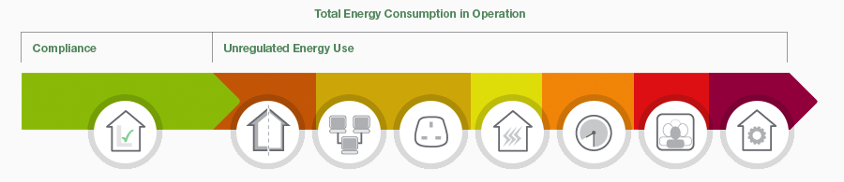
Net Zero Emissions – what it means for you
West Suffolk Hive March 2021
Oliver Ingwall King

Slide 2
Oliver Ingwall King
MIEMA Low Carbon Consultant
Energy Advisor, West Suffolk Council
Energy management, energy efficiency auditing / organisation carbon management
Environment and sustainability strategy
Carbon footprinting
Procurement tools
Communication and behavior change
Measurement and verification
Notes:
I have worked for Charities, Local Government, for corporate engineering consultancies and then set up this social enterprise, ÄlskaECO CIC

Slide 3
Net Zero Emissions - What you need to know?
100% Zero by a date – 2030, 2050 ?
Not likely to be possible so – carbon sequestration, carbon offsets
Steps we all need:
Carbon footprint
Action Plan
Track progress
Stay positive

Slide 4
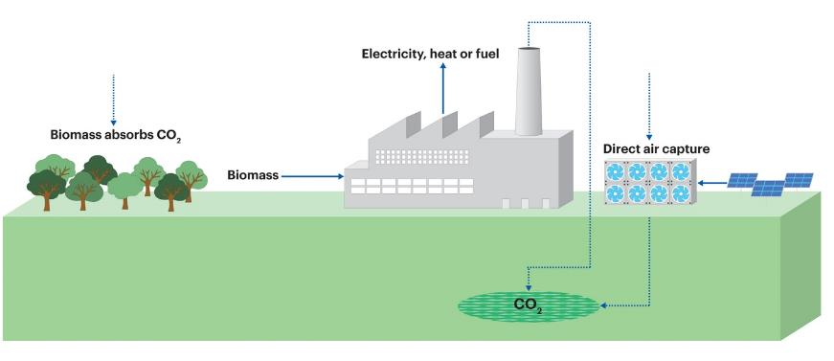
Net Zero Emissions – Offset/Sequester
Nature based solutions – trees etc.
Enhanced natural processes – soil carbon
Technology solutions
  Community projects
  BECCS
  Direct from air
Notes:
Published data on wood products is sparse, an issue highlighted by the Waste and Resources Action Programme (WRAP) in 2006 and 201031. Data used in this report for material consumption is based on studies from the USA, where production processes may not be representative of activity in the UK (e.g. different fuel mix to generate electricity). This data should therefore be viewed with caution.

Slide 5
UK Emissions
And Net Zero

Slide 6
Net Zero Emissions
“Net Zero is a statutory target ….. 100% reduction of UK greenhouse gas emissions by 2050 …… It is known as a net zero target because some emissions can remain if they are offset (i.e. by removal from the atmosphere and/or by trading in carbon units).”
Notes:
Carbon Neutral – a term which we have all heard many times. This is where you seek out emissions offset to balance our GHG emissions without the goal of 100% emissions reduction.

Slide 7
Provisional UK greenhouse gas emissions national statistics 2020

Slide 8
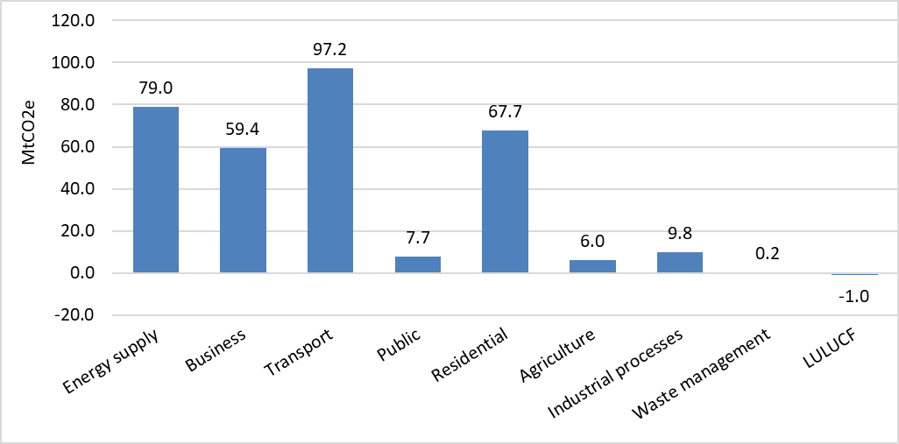
UK Greenhouse Gases
UK 2020 Provisional annual territorial greenhouse gas emissions, by source sector for carbon dioxide emissions, 1990-2020 (MtCO2e)
414.1 MtCO₂e total GHG emissions in 2020 down 49% from 1990
Notes:
Provisional UK greenhouse gas emissions national statistics 2020 - GOV.UK (www.gov.uk)

Slide 9
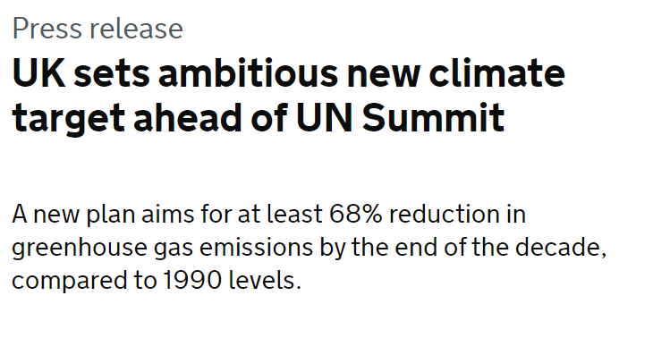
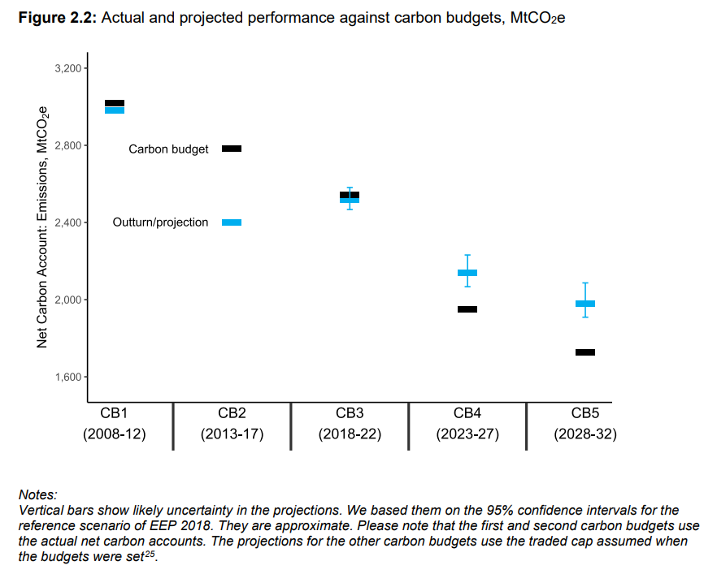
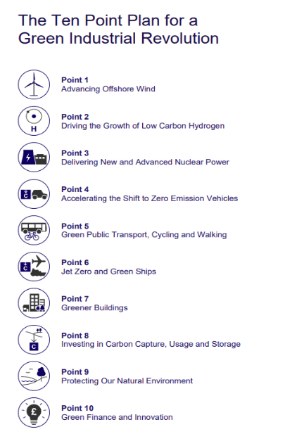
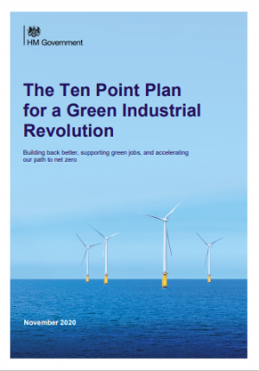
UK Approach (not sure it is a plan)
Notes:
Updated energy and emissions projections 2019 (publishing.service.gov.uk) – CB5 target for 57% saving but we are falling short
The Ten Point Plan for a Green Industrial Revolution (publishing.service.gov.uk)
UK sets ambitious new climate target ahead of UN Summit - GOV.UK (www.gov.uk) - Nationally Determined Contribution (NDC) under the Paris Climate Agreement

Slide 10
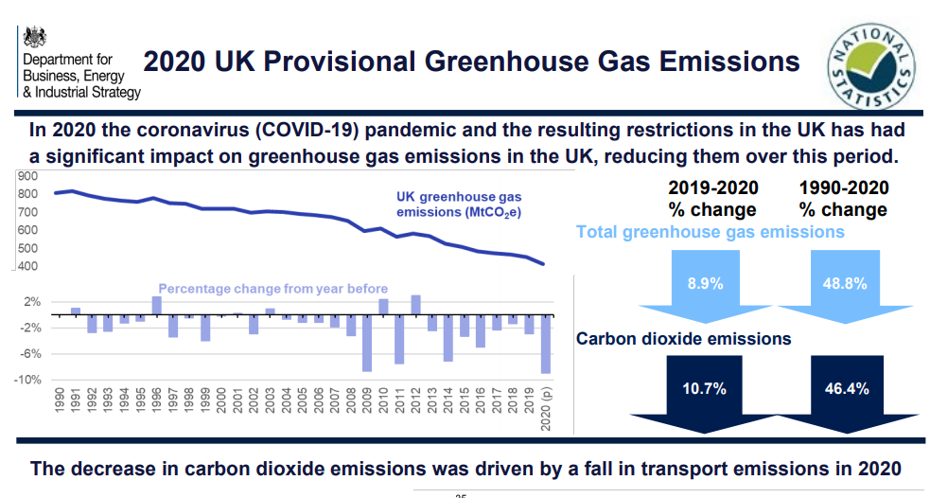
UK progress GHG Emissions (carbon footprint)
Notes:
Provisional UK greenhouse gas emissions national statistics 2020 - GOV.UK (www.gov.uk)

Slide 11
Suffolk Emissions
And Net Zero

Slide 12
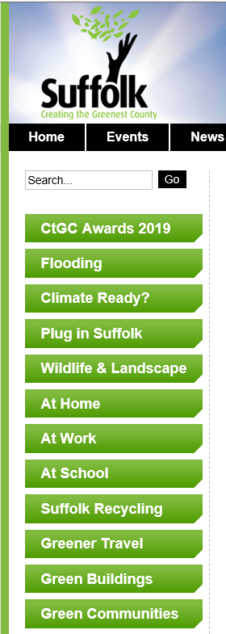
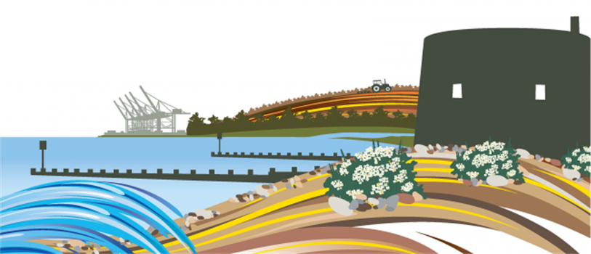
Climate and Environment Emergency will be wider than Council Operations
Notes:
As you can image, a climate and environment emergency is greater than the actions of the Council, internally or externally but our role is seen as key by all stating the change should occur.
I couldn’t find a good graphic so instead I took a list of the pages that are on the Green Suffolk website, I know that there are a number of Officers involved in providing information or support that is going into this network and the overarching aim of Creating the Greenest County

Slide 13
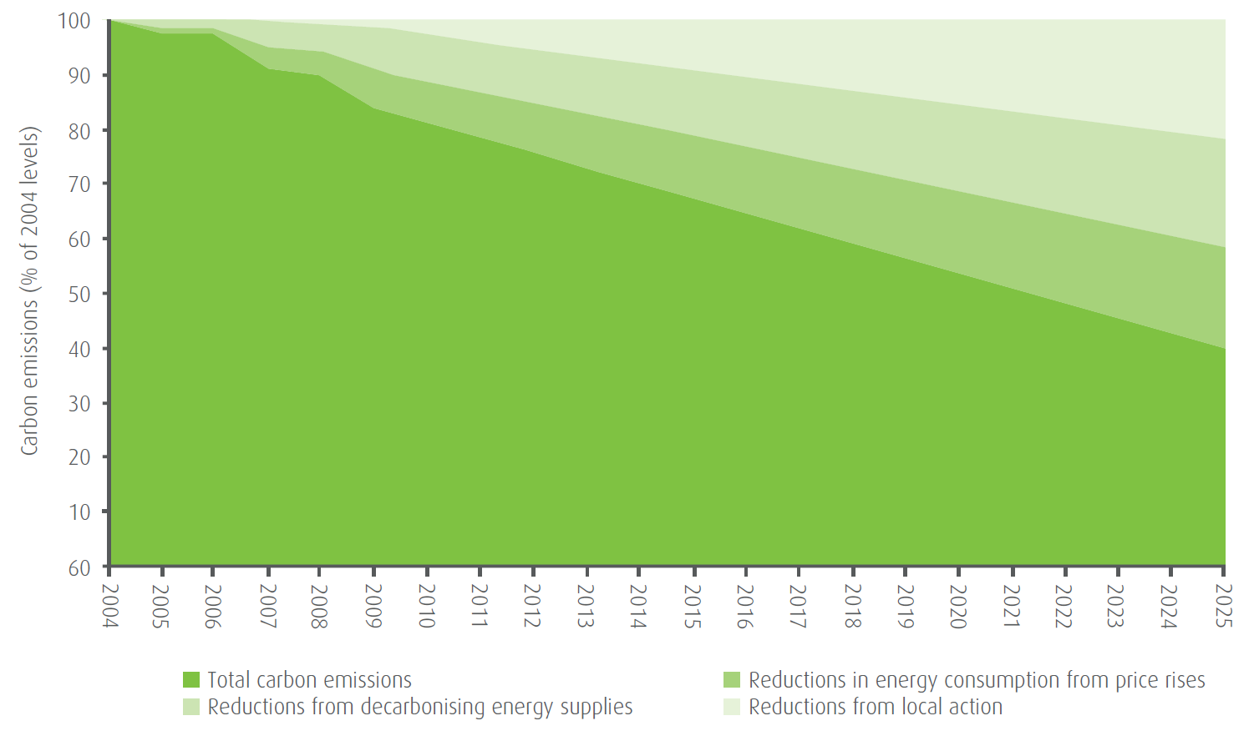
Green Suffolk Emissions monitoring

Slide 14
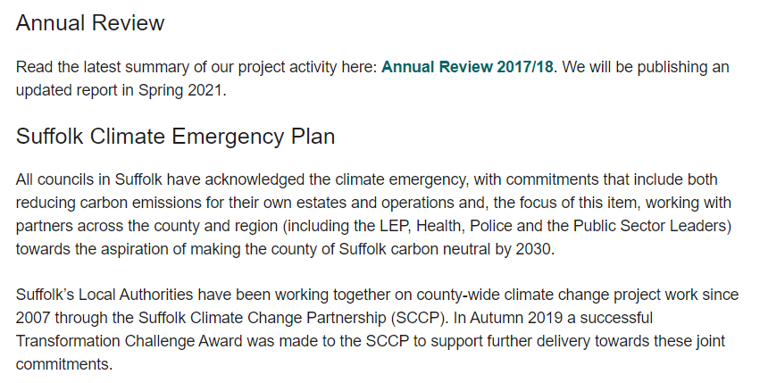
Suffolk Climate Emergency Plan

Slide 15
West Suffolk Emissions
And Net Zero

Slide 16
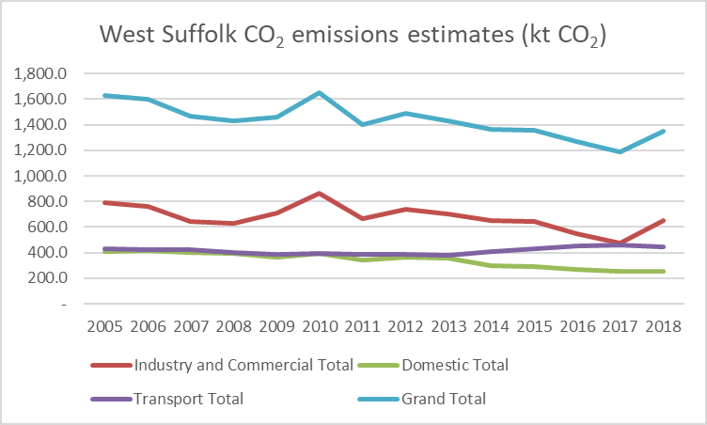
West Suffolk GHG Emissions
Local Authority territorial CO₂ emissions estimates within the scope of influence of Local Authorities 2005-2018 (kt CO2)
Notes:
West Suffolk 2018/19 was just under 7 ktCO2

Slide 17
West Suffolk Council Net Zero Emissions
Adopted a Net Zero Emissions by 2030 target for the Council’s greenhouse gas emissions
Council buildings and Operations at its buildings
Vehicles
Transport
Water
Set out a high-level action plan for how it will get there
Intends to build the business cases for each area of work
Works to get to net zero emissions cost neutral or even provide an income

Slide 18
Net Zero Trajectory and Carbon Budgets

Slide 19
What progress is being made?
Ongoing
  Improving efficiency of buildings
  Reducing impact of operations
  Investing in renewable energy
Public Sector Decarbonisation Scheme funding –
  ASHP to replace gas boilers at three sites – 100% or hybrid
  300 kWp of more solar PV
  Further battery energy storage
Transport
  Some movement on potential alternative fuels

Slide 20
Our Emissions – yours and mine
And Net Zero

Slide 21
Net Zero Emissions
We need:
Carbon footprint
Need a plan – action plan and target
Take action
Measure and report
Keep positive and keep making progress
Notes:
Published data on wood products is sparse, an issue highlighted by the Waste and Resources Action Programme (WRAP) in 2006 and 201031. Data used in this report for material consumption is based on studies from the USA, where production processes may not be representative of activity in the UK (e.g. different fuel mix to generate electricity). This data should therefore be viewed with caution.

Slide 22
Carbon Footprint
I’ll show you mine
House / Building
Car
Transport and Travel
Waste and Water
Secondary

Slide 23
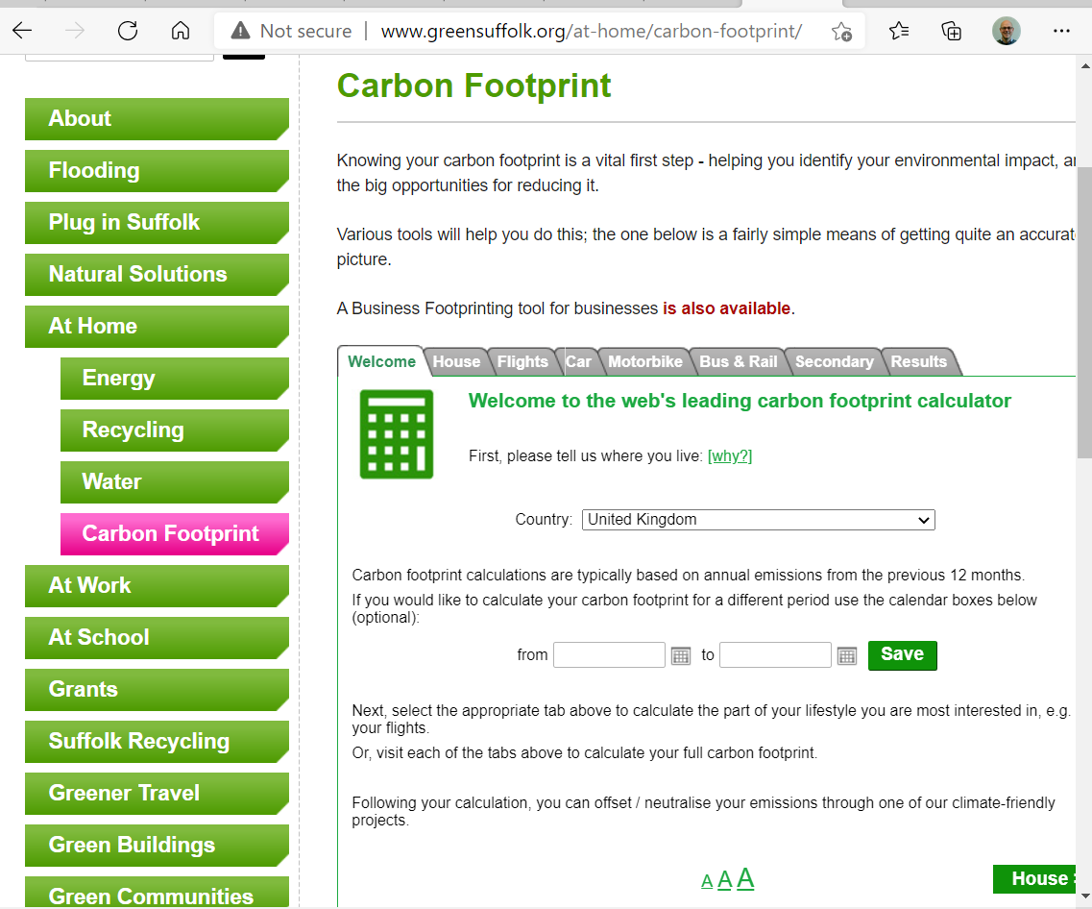
What’s your carbon footprint?

Slide 24
What’s my plan?
Focused on home – insulate, 100% green energy, ASHP
Reduced work commute – myself and wife
Reduced meat
Consider each purchase
  Environmental management
  Carbon footprint
  Emissions reduction activities
  Environmental and ecological impacts
Measure and report
Keep positive and keep making progress
Notes:
Published data on wood products is sparse, an issue highlighted by the Waste and Resources Action Programme (WRAP) in 2006 and 201031. Data used in this report for material consumption is based on studies from the USA, where production processes may not be representative of activity in the UK (e.g. different fuel mix to generate electricity). This data should therefore be viewed with caution.

Slide 25
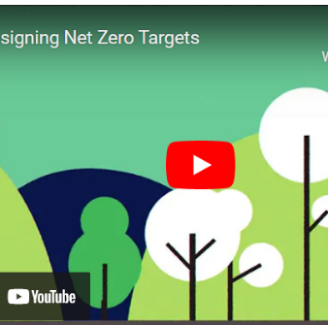
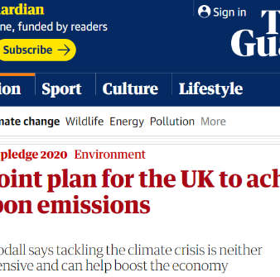
Have you started?
A nine-point plan for the UK to achieve net zero carbon emissions | Environment | The Guardian
What’s your plan?
https://youtu.be/VBPg1k0SIRM
Notes:
Published data on wood products is sparse, an issue highlighted by the Waste and Resources Action Programme (WRAP) in 2006 and 201031. Data used in this report for material consumption is based on studies from the USA, where production processes may not be representative of activity in the UK (e.g. different fuel mix to generate electricity). This data should therefore be viewed with caution.

Slide 26
Net Zero Emissions in our community
I don’t have any answers

Slide 27
How do you make a Net Zero West Suffolk community?
Planning policy – New Local Plan being developed
Community energy projects
Community carbon footprint / action network
……….?
………..?
Notes:
Published data on wood products is sparse, an issue highlighted by the Waste and Resources Action Programme (WRAP) in 2006 and 201031. Data used in this report for material consumption is based on studies from the USA, where production processes may not be representative of activity in the UK (e.g. different fuel mix to generate electricity). This data should therefore be viewed with caution.

Slide 28
Can we really achieve Net Zero Emissions?
All of us….

Slide 29
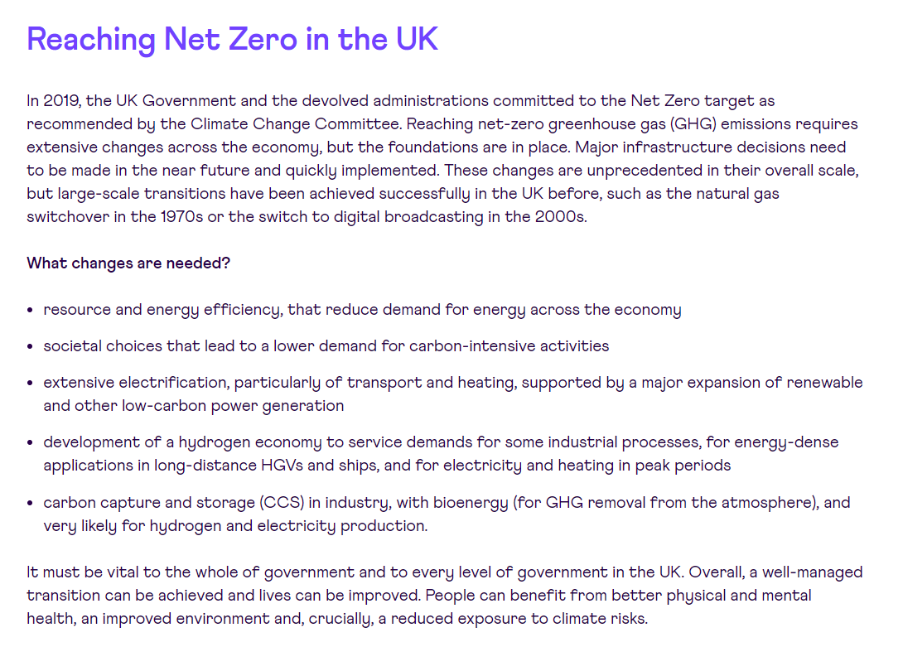


Slide 30
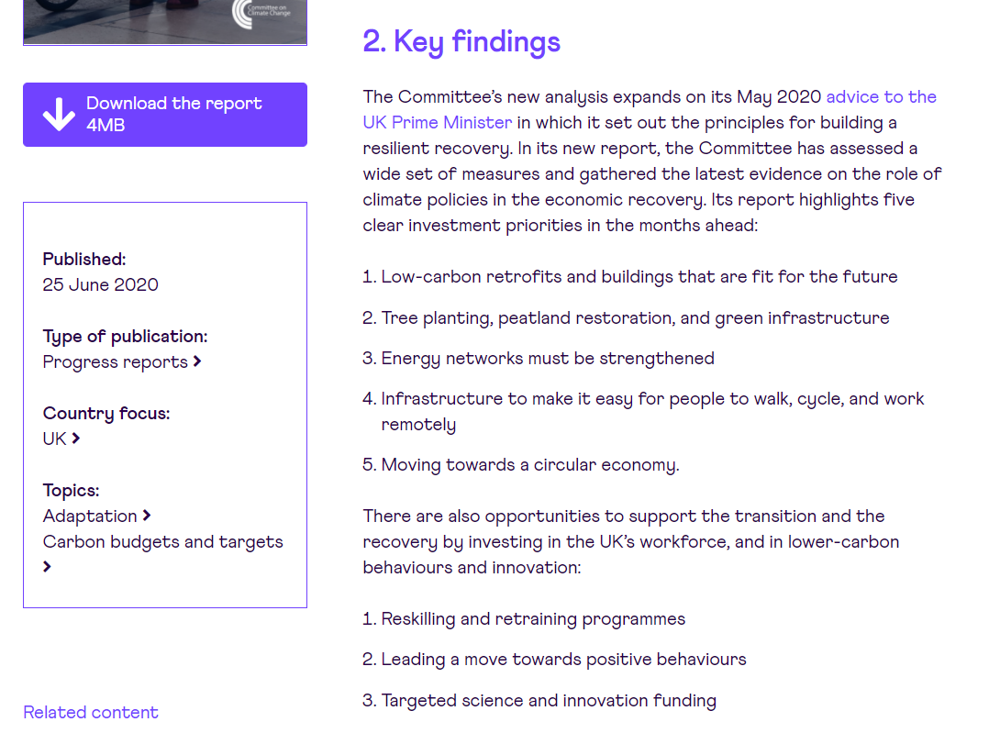

Slide 31
Questions?

Slide 32
Net Zero Emissions – Offset/Sequester (who knows)

Slide 33
Is it really good?
Electric Vehicle
EVs are responsible for considerably lower emissions over their lifetime than conventional vehicles across Europe as a whole.
As countries decarbonise electricity generation emissions will fall for existing EVs and manufacturing emissions will fall for new EVs.
“The extraction of raw materials is inherently associated with environmental and social problems, and the commodities needed for battery technology are no exception in this regard.”
Benefits of low carbon diet
“UN: Growing threat to food from decline in biodiversity”
Biodiversity is threatened because pollution, overexploitation, natural disasters, invasive alien species, tourism, intensive agriculture. The change in eating habits combined with the pursuit of profitable varieties led to the abandonment of local varieties and cultural degradation of specific products.
We are in an era of unprecedented threats to biodiversity: 15 out of 24 ecosystems are assessed to be in decline (Steinfeld et al., 2006).
Notes:
https://www.carbonbrief.org/factcheck-how-electric-vehicles-help-to-tackle-climate-change
https://www.agora-verkehrswende.de/fileadmin/Projekte/2017/Nachhaltige_Rohstoffversorgung_Elektromobilitaet/Agora_Verkehrswende_Rohstoffestrategien_EN_WEB.pdf
The paper also talks about available stocks of rare earth minerals and also supply chain issues
https://www.bbc.co.uk/news/science-environment-47308235
http://www.fao.org/3/i3004e/i3004e04.pdf
It then goes on to talk about absurd transport costs.
The emissions from agriculture
The amount of greenhouses in southern Spain – so land lost to buildings and biodiversity
And then the migrant and exploited labour, doe anyone watch Simon Reeves series on BBC?
The diminishing genetic stocks as we focus more and more on economic crops
Only about 30 crop species provide 95 percent of food energy in the world while 7 000 species, that are partly or fully domesticated, have been known to be used in food including many of the so-called underutilized, neglected or minor crops (Williams and Haq, 2002)

Slide 34
Carbon footprint - Scope 1, 2, 3
Scope 1 – All Direct Emissions from the activities of an organisation or under their control. Including fuel combustion on site such as gas boilers, fleet vehicles and air-conditioning leaks.
Scope 2 – Indirect Emissions from electricity or heat purchased and used by the organisation. Emissions are created during the production of the energy and eventually used by the organisation.
Scope 3 – All Other Indirect Emissions from activities of the organisation, occuring from sources that they do not own or control. These are usually the greatest share of the carbon footprint, covering emissions associated with business travel, procurement, waste and water.
Notes:
Benchmarking performance? In terms of strategy it can sometimes be useful to see how others are doing, peers, competitors etc.
Wetland and Wildfowl Trust - https://www.wwt.org.uk/who-we-are/sustainability#,
Fit for the Future Network managed by National Trust, I know that there are a range of others
The report concludes: “The consequences are clear; if insect declines are not halted, terrestrial and freshwater ecosystems will collapse, with profound consequences for human wellbeing.” https://www.somersetwildlife.org/news/wildlife-trusts-call-urgent-action-insects-new-report-reveals-true-impacts-unnoticed
https://www.devonwildlifetrust.org/what-we-do/defending-wildlife/meeting-threats-climate-change
https://www.shropshirewildlifetrust.org.uk/climate-crisis
https://www.avonwildlifetrust.org.uk/what-we-do/our-vision
https://www.somersetwildlife.org/sites/default/files/2019-10/Environmental%20Policy%20document_0.pdf
Net-zero Cornwall Wildlife Trust by 2030

Slide 35
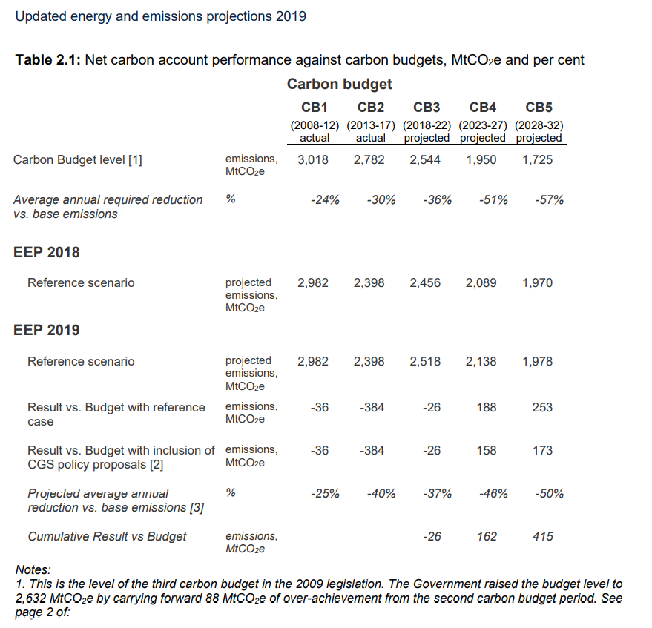

Slide 36
Environmental management
Governance
Reporting
Data
Action plan
Delivery
Trajectory - progress vs aspirations

Slide 37
Greenhouse Gases?
Which gases can you name?
Basket of Seven GHGs
  carbon dioxide (CO2), - 1
  methane (CH4), - 20 years = 96 and 100 years 28 - 40
  nitrous oxide (N2O), - 298
  hydrofluorocarbons (HFC), - <1300
  perfluorocarbons (PFC), - 7,000 to 12,000 (electronics and sporting goods, halocarbons)
  sulphur hexafluoride (SF6) – 22,800 100 years
  and nitrogen trifluoride (NF3). 17,200 (electronics)

